Slide 1
流体直观理解补充
智能科学与技术（数据科学） 许笑颜

Slide 2
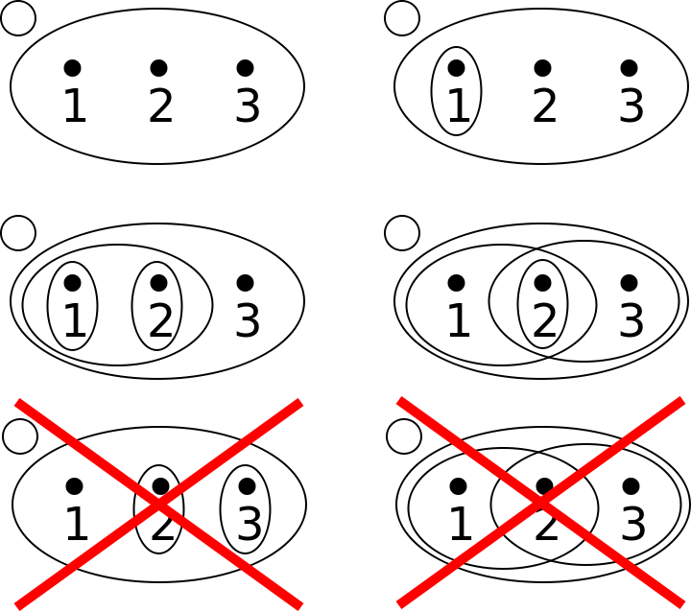
判断是否是拓扑空间

Slide 3
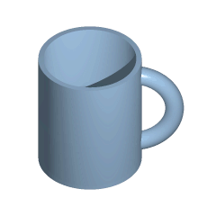
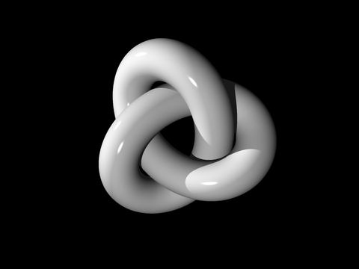
同胚概念理解
拓扑学家为不知甜甜圈与咖啡杯之分别者。

Slide 4
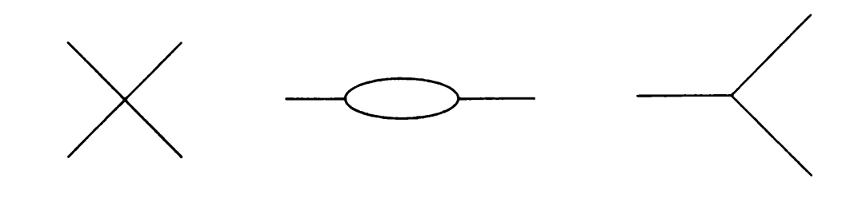
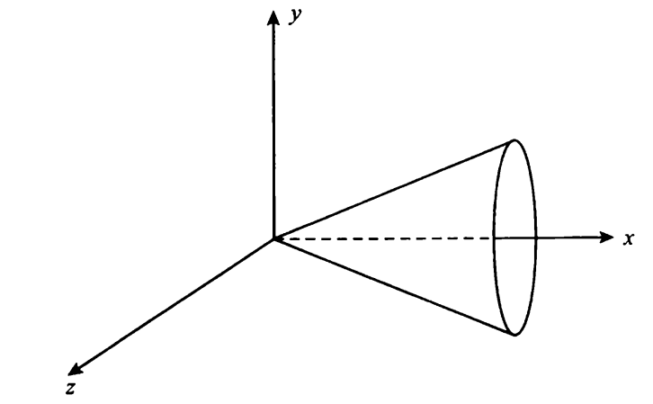
识别是否为流形
不是流形的一维图形：
不是流形的三维锥面图形：

Slide 5
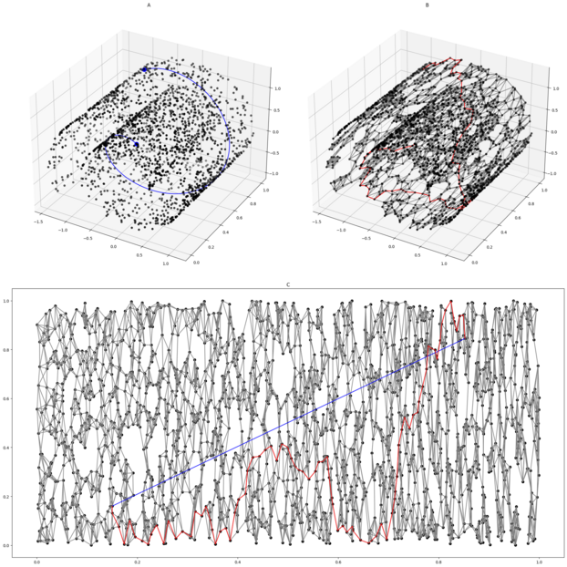
Intrinsic Learning——Isomap
Determine the neighbors of each point.
All points in some fixed radius.
K nearest neighbors.
Construct a neighborhood graph.
Each point is connected to other if it is a K nearest neighbor.
Edge length equal to Euclidean distance.
Compute shortest path between two nodes.
Dijkstra's algorithm
Floyd–Warshall algorithm
Compute lower-dimensional embedding.
Multidimensional scaling

Slide 6
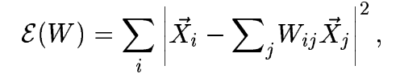
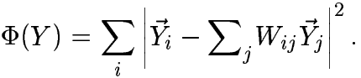
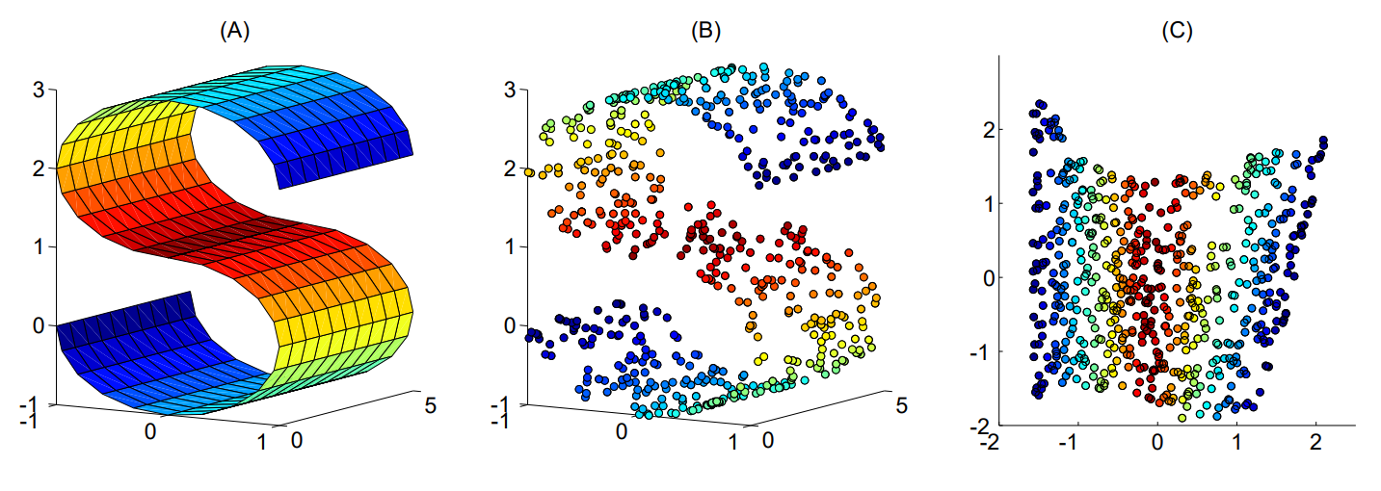
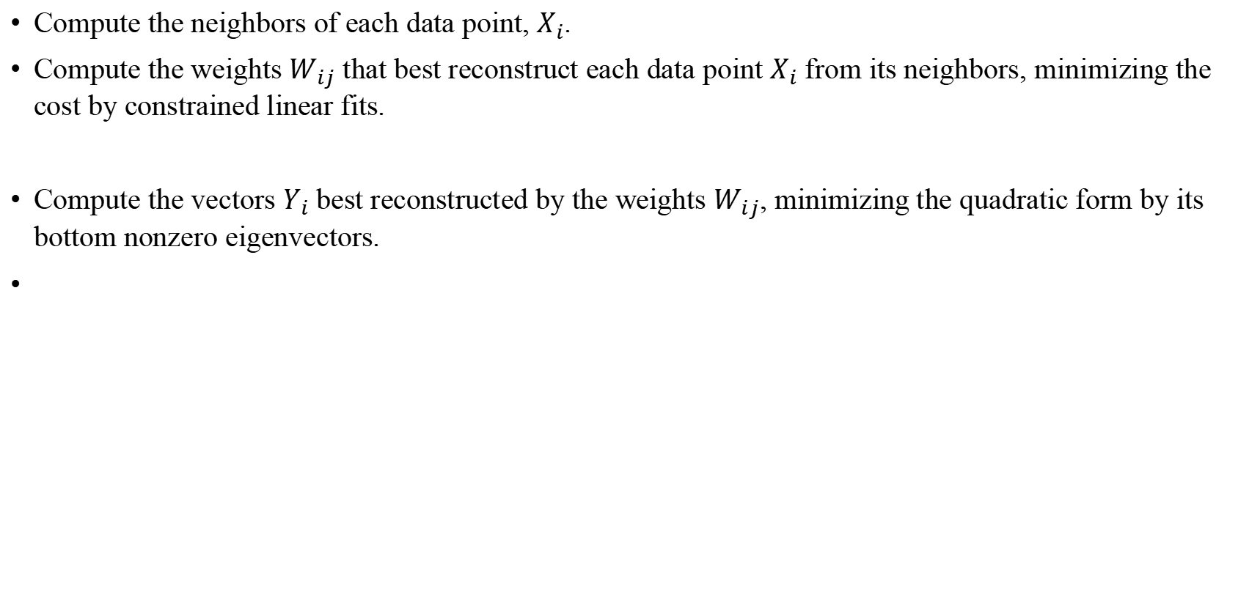
Intrinsic Learning——LLE
Compute the neighbors of each data point, $X_{i}$.
Compute the weights $W_{ij}$ that best reconstruct each data point $X_{i}$ from its neighbors, minimizing the cost by constrained linear fits.
Compute the vectors $Y_{i}$ best reconstructed by the weights $W_{ij}$, minimizing the quadratic form by its bottom nonzero eigenvectors.

Slide 7
《Intrinsic dimension of data representations in deep neural networks》
智能科学与技术（数据科学） 许笑颜

Slide 8
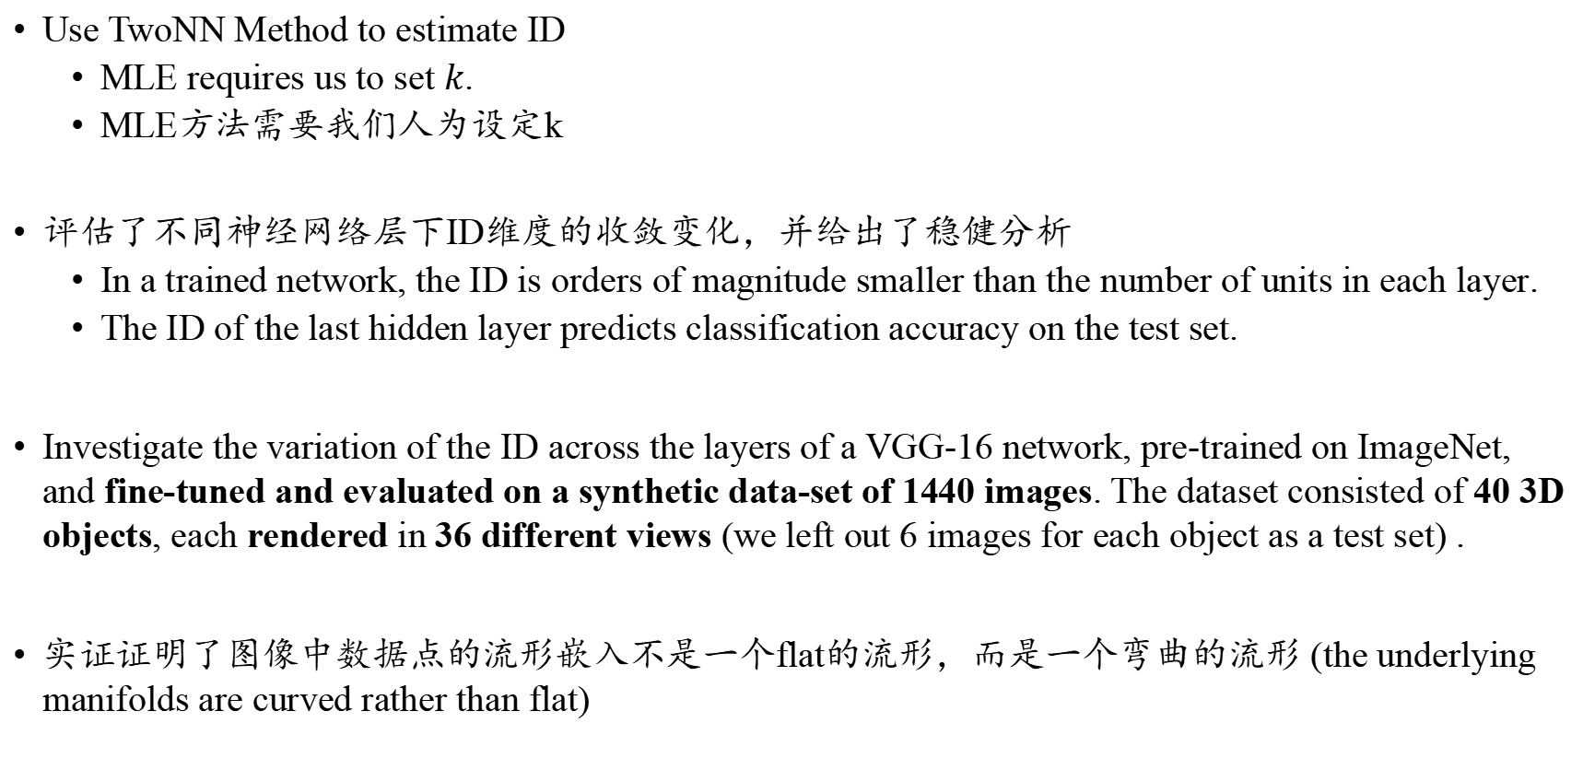
What makes it different from MLE Intrinsic Dimension?
Use TwoNN Method to estimate ID
MLE requires us to set $k$.
MLE方法需要我们人为设定k
评估了不同神经网络层下ID维度的收敛变化，并给出了稳健分析
In a trained network, the ID is orders of magnitude smaller than the number of units in each layer.
The ID of the last hidden layer predicts classification accuracy on the test set.
Investigate the variation of the ID across the layers of a VGG-16 network, pre-trained on ImageNet, and fine-tuned and evaluated on a synthetic data-set of 1440 images. The dataset consisted of 40 3D objects, each rendered in 36 different views (we left out 6 images for each object as a test set) .
实证证明了图像中数据点的流形嵌入不是一个flat的流形，而是一个弯曲的流形 (the underlying manifolds are curved rather than flat)

Slide 9
TwoNN Algorithm for Computing Intrinsic Dimension
TwoNN is based on computing the ratio between the distances to the second and first nearest neighbors (NN) of each data point.
Weak assumption: the density is constant on the scale of the distance between each point and its second nearest neighbor.
Advantage:
This allows overcoming the problems related to the curvature of the embedding manifold and to the local variations in the density of the data points.
Disadvantage:
Small IDs: the estimated values remain very close to the ground truth ID, when this is smaller than 20.
Larger IDs: the approach moderately underestimates the correct value, especially if the density of data is non-uniform.

Slide 10
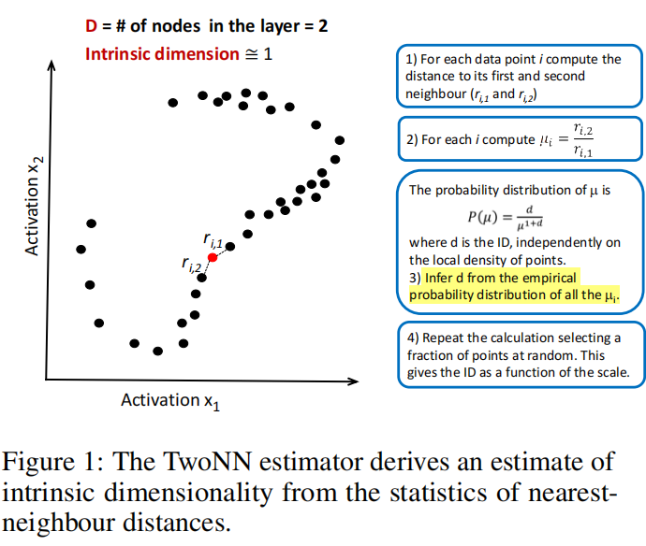
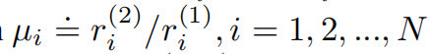
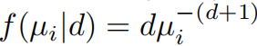
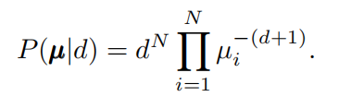
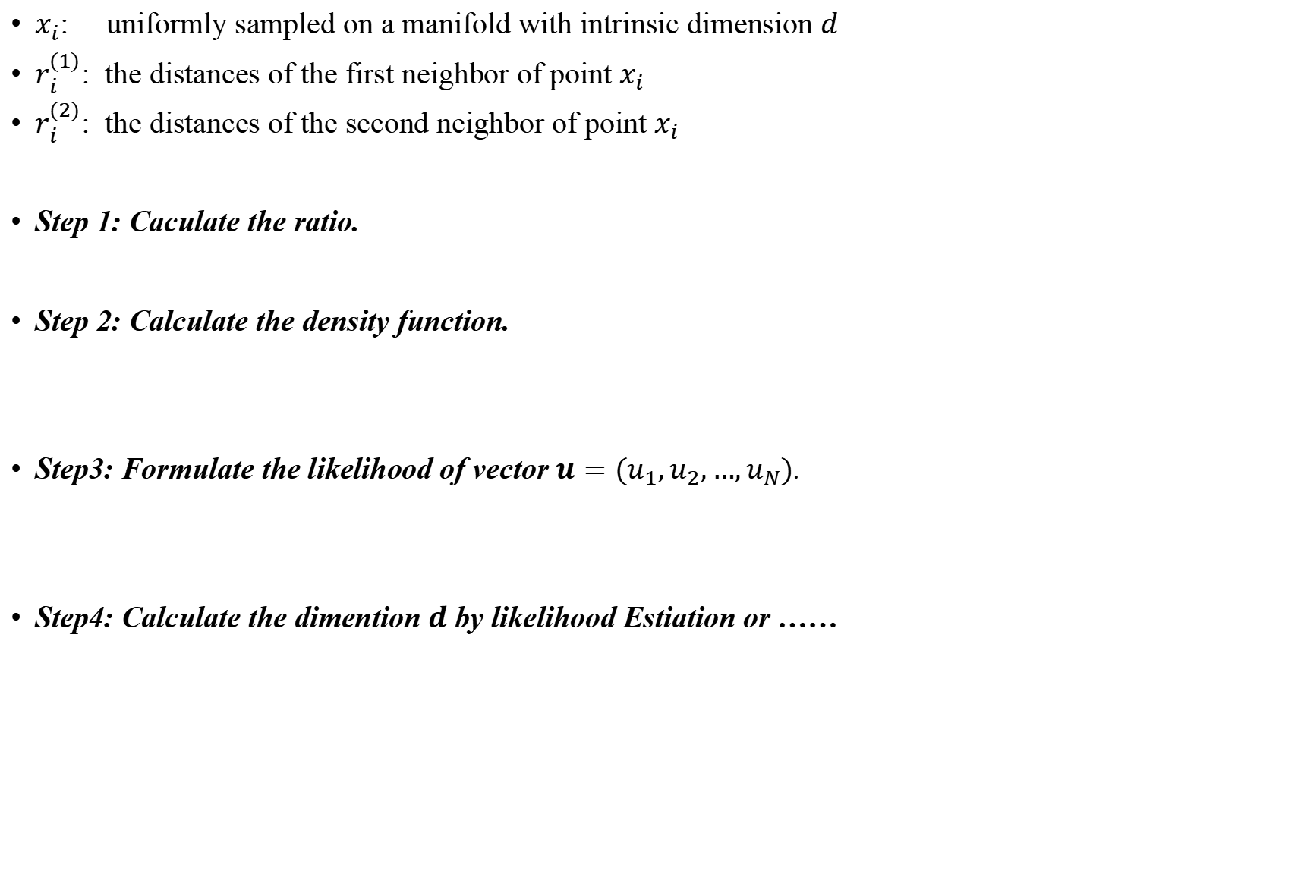
TwoNN Algorithm for Computing Intrinsic Dimension
$x_{i}$: uniformly sampled on a manifold with intrinsic dimension $d$
$r_{i}^{(1)}$: the distances of the first neighbor of point $x_{i}$
$r_{i}^{(2)}$: the distances of the second neighbor of point $x_{i}$
Step 1: Caculate the ratio.
Step 2: Calculate the density function.
Step3: Formulate the likelihood of vector $u=(u_{1},u_{2},…,u_{N})$.
Step4: Calculate the dimention $d$ by likelihood Estiation or ……

Slide 11
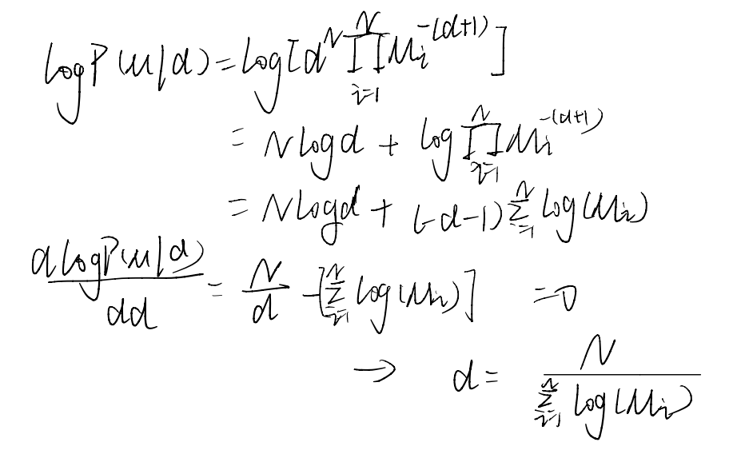
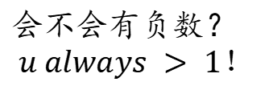
TwoNN Algorithm for Computing Intrinsic Dimension
Step4: Calculate the dimention d by likelihood Estiation or ……
Plan A: likelihood Estimation:
Plan B：Employ the empirical cumulate of the distribution of the µ values to reduce the ID estimation task to a linear regression problem.
会不会有负数？
$$u always > 1！$$

Slide 12
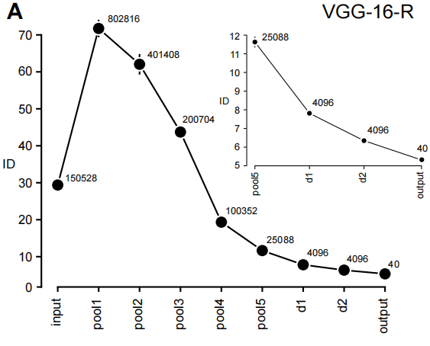
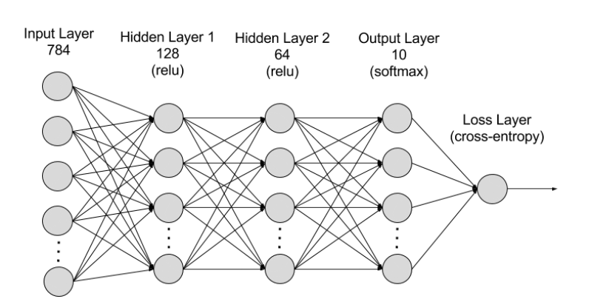
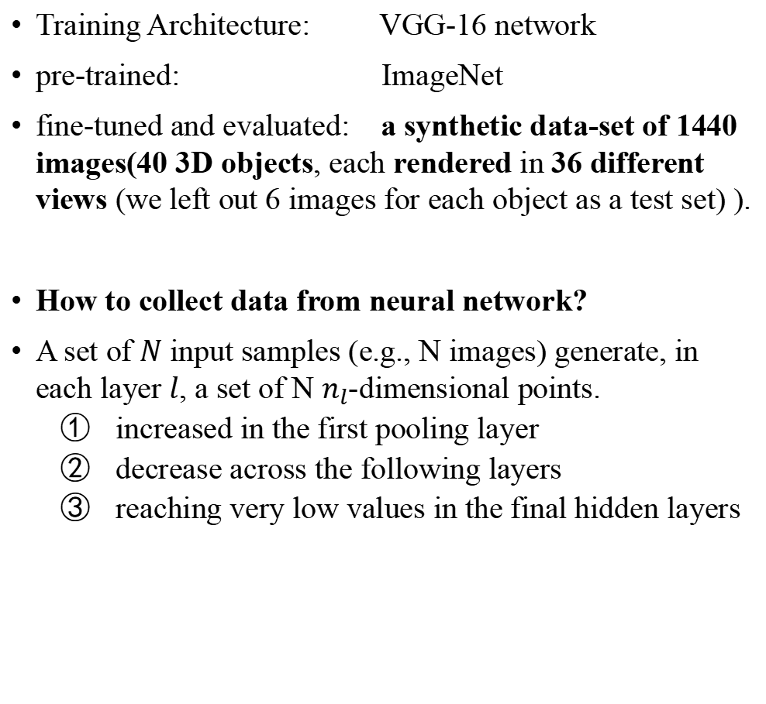
Experiment on 40 3D rendering objects from 36 views
Training Architecture: VGG-16 network
pre-trained: ImageNet
fine-tuned and evaluated: a synthetic data-set of 1440 images(40 3D objects, each rendered in 36 different views (we left out 6 images for each object as a test set) ).
How to collect data from neural network?
A set of $N$ input samples (e.g., N images) generate, in each layer $l$, a set of N $n_{l}$-dimensional points.
increased in the first pooling layer
decrease across the following layers
reaching very low values in the final hidden layers
40 3D Object！

Slide 13
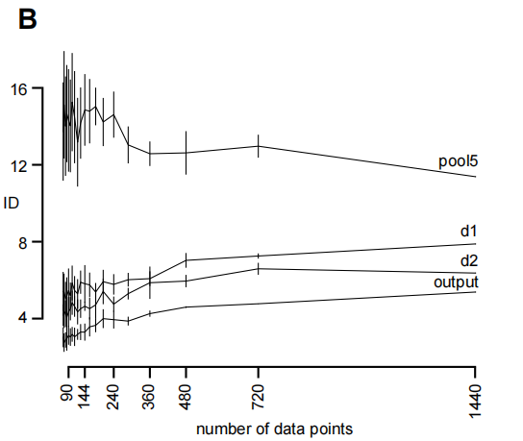
Experiment on 40 3D rendering objects from 36 views
Analysis 1: Across Differenr Sample Size
Repeat the analysis on subsamples randomly chosen on the data manifold.
The estimated IDs were indeed stable across a wide range of sample sizes!

Slide 14
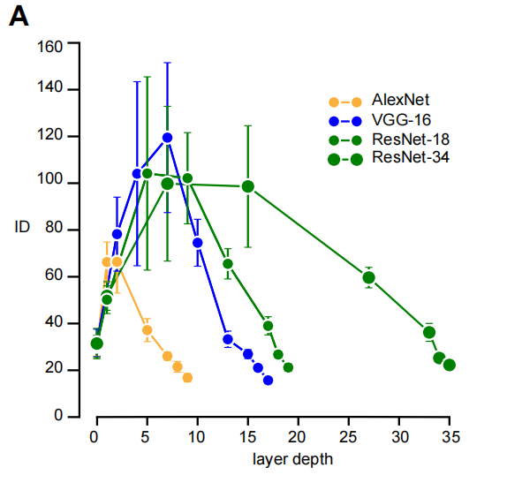
Experiment on 40 3D rendering objects from 36 views
Analysis 2: Across Different Training Architecture
Are the ‘hunchback’ shape of the ID variation specific to this particular network architecture and dataset?
Compute the average ID of the object manifolds corresponding to the 7 biggest ImageNet categories, using 500 images per category

Slide 15
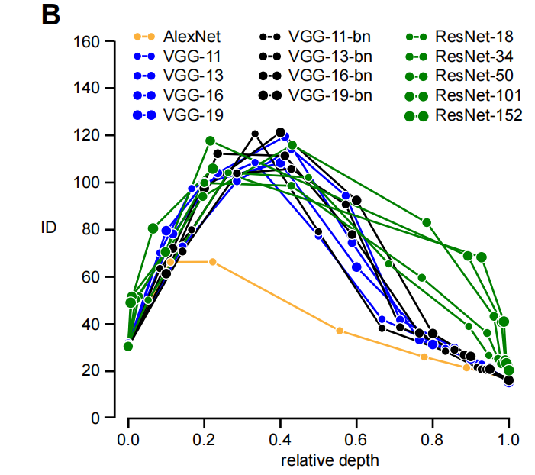
Experiment on 40 3D rendering objects from 36 views
Analysis 3: relative (rather than the absolute) depth of a layer?
The ID profiles approximately collapsed onto a common hunchback shape, despite considerable variations in the architecture, number of layers, and optimization algorithms.

Slide 16
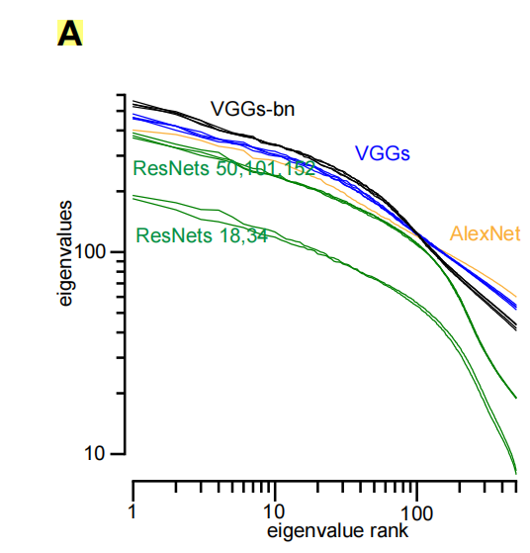
Experiment on curved manifolds
Whether our observations or our method reflect the fact that data points live on low-dimensional, yet highly curved manifolds?
Perform linear dimensionality reduction (principal component analysis, PCA) on the normalized covariance matrix for each layer and network.
The absence of a gap in the spectrum！

Slide 17
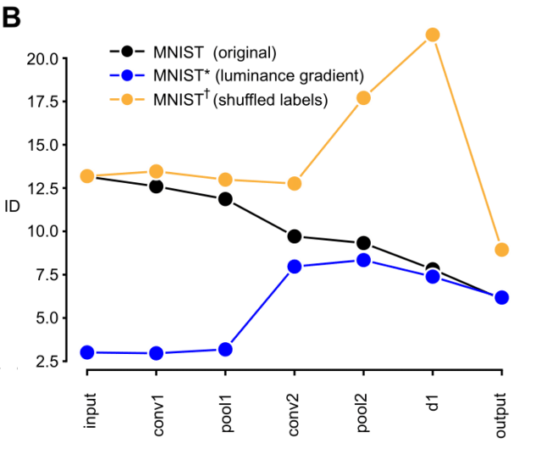
Experiment on Dataset with Random Labels
randomly shuffling the labels on MNIST (we refer to the shuffled data as MNIST†)
overfitting noisy labels leads to an expansion of the dimensionality
A network trained on inconsistent data can be recognized without estimating its performance on a test set, but by simply looking at whether the ID increases substantially across its final layers.

Slide 18
怎么计算3D点云的Intrinsic Dimension?

Slide 19
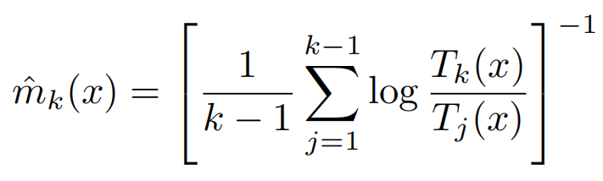
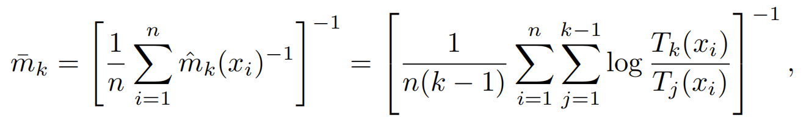
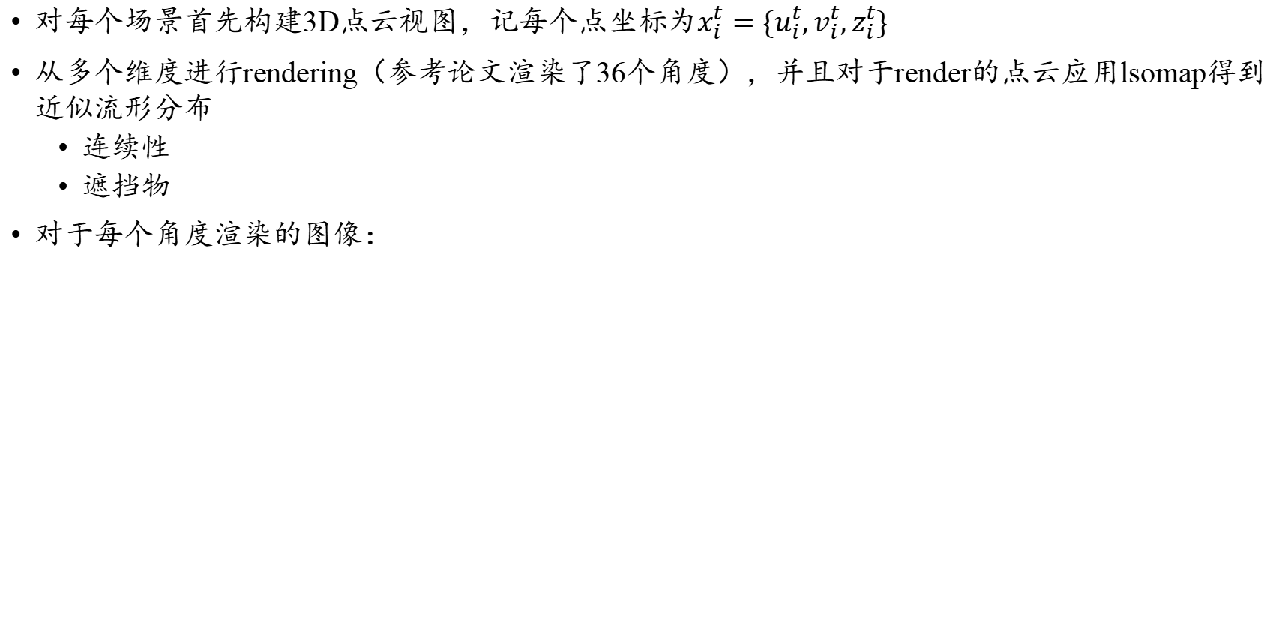
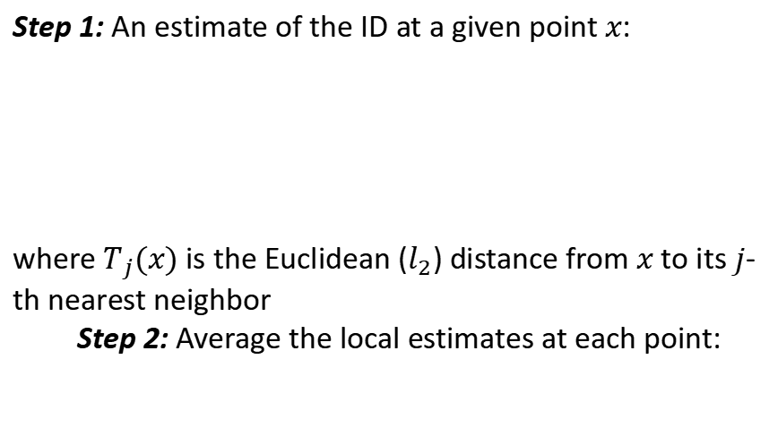
Plan A: Multi-dimension rendering & TwoNN
对每个场景首先构建3D点云视图，记每个点坐标为$x_{i}^{t}=\{u_{i}^{t},v_{i}^{t},z_{i}^{t}\}$
从多个维度进行rendering（参考论文渲染了36个角度），并且对于render的点云应用lsomap得到近似流形分布
连续性
遮挡物
对于每个角度渲染的图像：
TwoNN
MLE
Step 1: An estimate of the ID at a given point $x$:
where $T_{j}(x)$ is the Euclidean ($l_{2}$) distance from $x$ to its $j$-th nearest neighbor
Step 2: Average the local estimates at each point:

Slide 20
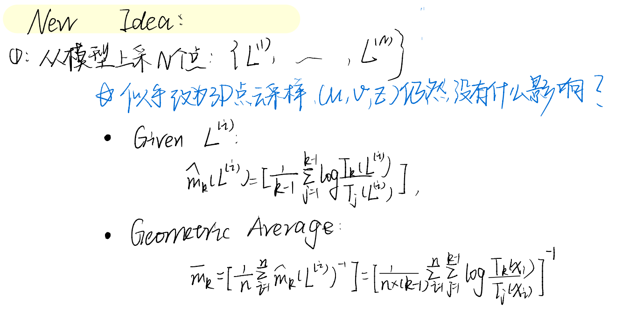
MLE估计会不会收到点的影响？
似乎不会？？

Slide 21
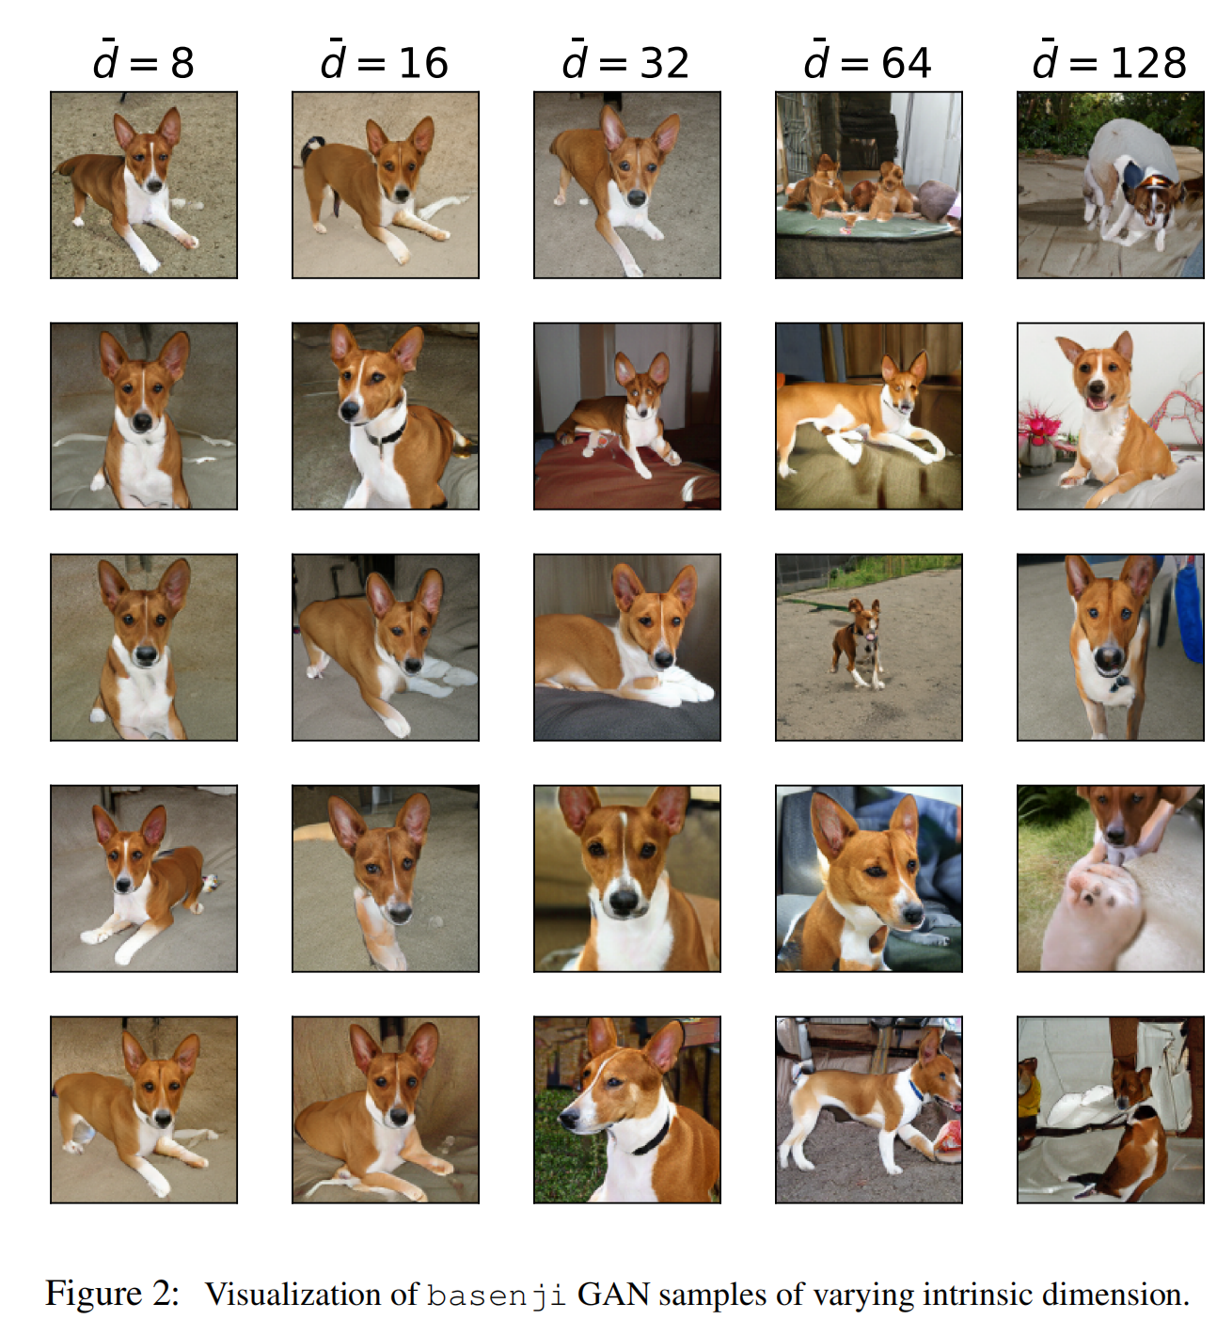
关于研究的一点疑惑
研究目的为多视角下的三维运动建模，
进行流形采样计算维度的时候能不能先使用一些流形学习算法，去从一个潜在的图像中学习到潜在的流形分布，

